Slide 1
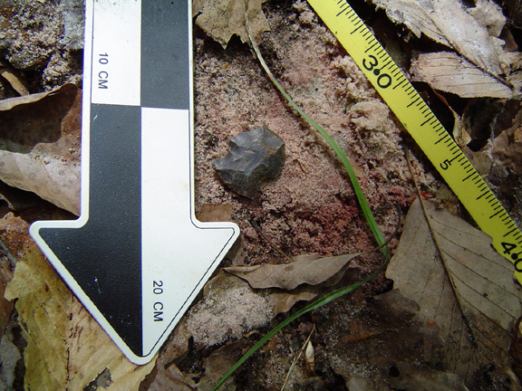
What is Archaeology?
Photo from my work at
Mammoth Cave National Park.
Notes:
This PowerPoint was created by Amy McCray, a trained Anthropologist. You can download and use this PowerPoint for personal or classroom use. Please enjoy it, I hope it is informative and helpful in learning the basics of archaeology and what archaeologists do.

Slide 2

Archaeologists DO NOT:
Study dinosaurs.
Just look for pretty or valuable objects.
Just pick up artifacts.
Spend all their time just digging.
Buy, sell, or put a price on artifacts.
Notes:
Many people have the wrong idea about what archeologists do. But before we learn what they do, lets learn what they don’t do. Archeologists do not study dinosaurs, that is paleontology.
We do not just look for pretty or valuable objects. Every day, boring items can tell a lot about a person or group.
We don’t just pick up the artifacts we find. Archaeologists must take notes, take photographs, and make maps so that we can recreate how objects are associated or in relation to one another. The placement of items can tell us what an item may have been used for, not just what the item is.
We do not spend all our time digging, that’s actually a minor part of the process—we spend most of our time analyzing artifacts. Analyzing is looking at something to figure our what it is or what it was used for.
We do not buy, sell or put a price on artifacts. If you ask an archaeologist they will tell you what something is if they can, but they will not tell you what it’s worth.

Slide 3
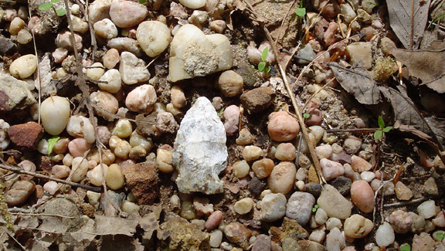
So what is archaeology?
The systematic, scientific recovery and analysis of artifacts in order to answer questions about past human culture and behavior.
Photos from my work at Mammoth Cave National Park.
Notes:
Archeology is the systematic, scientific recovery and analysis of artifacts in order to answer questions about past human culture and behavior. But what do these words mean?

Slide 4
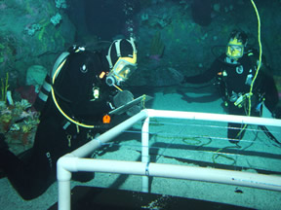
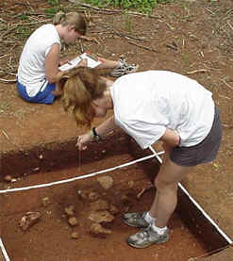
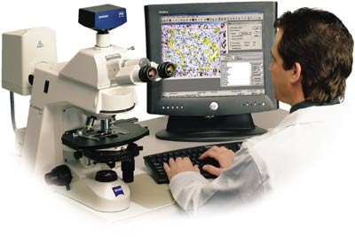
Recovery / Analysis: To collect and study artifacts.
Notes:
Recovery is to collect artifacts.
Analysis is to study artifacts and figure out what they are and how they were used. Archeologists use several methods borrowed from other scientific fields to do this. This is what archaeologists spend most of their time doing.

Slide 5
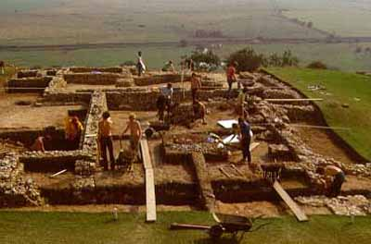
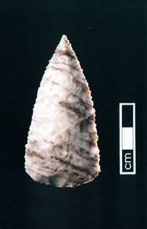

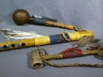



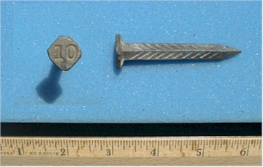
Artifact: Any item resulting from human activity.
Notes:
An artifact is any item resulting from human activity. Fossils are not artifacts, they were not made by humans.
Artifacts are anything human hands have used. Whether they just picked something up to use or if they made it. Even buildings are considered artifacts. Artifacts are also things left behind. Think about what we leave behind—things we no longer want or need. That’s our garbage! So often archaeologists are studying garbage.

Slide 6
Question-based: Archaeologists study artifacts in order to answer questions about how humans lived.
Did they have religion?
Did they have disease or sickness?
What tools did they use?
What did they eat?
When did they live?
Did they have laws?
Did they hunt or farm?
Where did they live?
Who took care of the children?
Did they have writing?
Did they have art?
How large was the group?
Notes:
Archeology is a question-based science. Archeologists always develop a question they want answered before they do anything else. These are some of the questions they may ask and try to find the answer to.

Slide 7
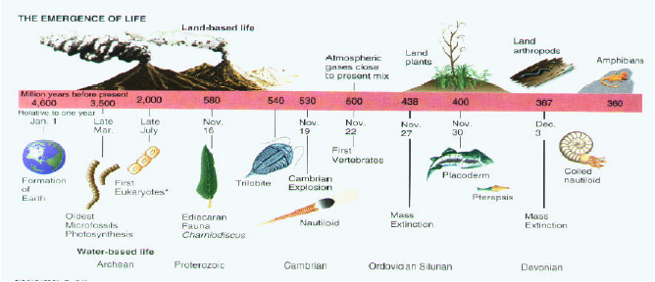
Past: Archaeologists study human cultures that are no longer living.
Notes:
The past can be 50 years ago or 50 thousand years ago. Evolutionist believe the earth is millions of years old.

Slide 8
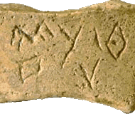
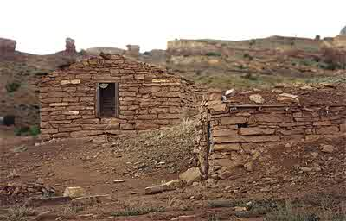
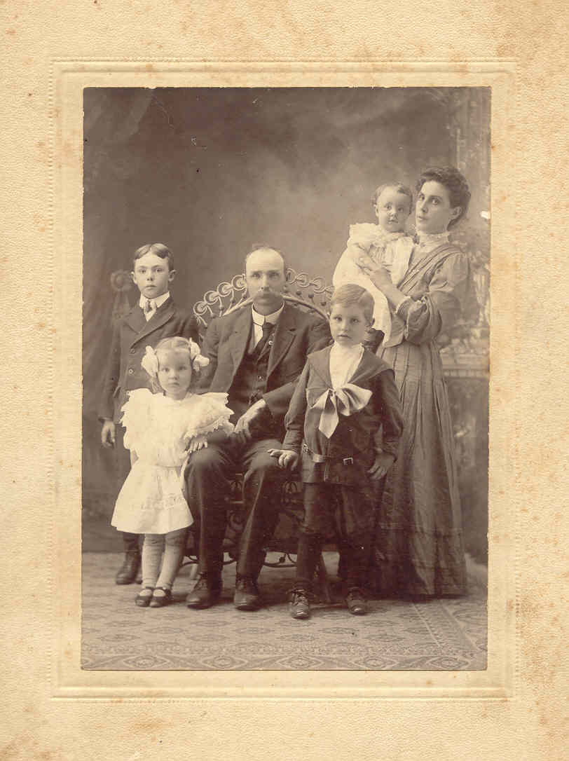
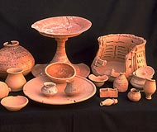
Culture: Any learned behavior that is shared with others.
Notes:
So why do we study human bones and artifacts? Archaeologists are trying to learn about past culture and behavior. Culture is any behavior or tradition shared with others. Every group of people has culture. The United States has culture—our holiday traditions to how we learn to talk—these are part of our culture. There are even subcultures or a culture within a culture. Children are a subculture. They do things different than adults and have their own way of communicating and doing things.

Slide 9
So what is Archaeology?
More simply it is the study of artifacts left behind to learn about people from the past.
OR
People
and their
Garbage
Notes:
So if archaeology is the study of artifacts left behind to learn about people from the past, think about what we leave behind—things we no longer want or need. That’s our garbage! So, often archaeologists are studying garbage. There are even archaeologists today who study landfills out in California to find out about what people throw out today.

Slide 10
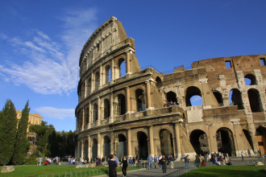
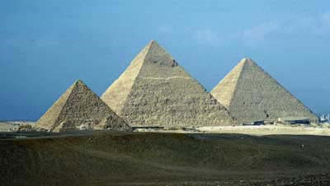
Types of Archaeology
Prehistoric Archaeology
  Before writing.
Historical Archaeology
  Document/writing assisted
Classical Archaeology
  Greek and Roman
Biblical Archaeology
Underwater Archaeology
  Shipwrecks or anything else under water.
Industrial Archaeology
  Industrial Revolution and other modern structures
Egyptologists, Mayanists, Assyriologists
  Study of specific civilizations or time periods.
Cultural Resource Management
  Management and assesment of significant cultural resources.
PowerPoint created by Amy J McCray, 2005, updated 2007.
Notes:
Many archeologists go on in their training to specialize in specific times, places, or environments. The ones listed above are the few of many special interests.
Prehistoric archaeologists study cultures with no writing.
Historic archaeologists use written documents and photographs to help them with their work.
Classical Archaeology is the study of the ancient Greeks and Romans.
Biblical archaeologist try to prove places and events described in the bible.
Underwater Archaeologists wear scuba gear and use the same methods as other archaeologists to study archaeological remains. They mostly look at shipwrecks. Because things in water are always cold and wet they don’t rot very fast. Archaeologists can find an entire ship in one piece because of the constant environment.
Industrial Archaeology is the study of the Industrial Revolution and other modern structures.
The study of Egypt, the Mayans, and ancient Assyria (Babylon)
Cultural Resource Management is the management and assessment of cultural resources. That means whenever something new is built an archaeologist must come in and make sure that there are no artifacts being lost or destroyed. We also keep track of places we know have artifacts and make sure they aren’t being damaged or stolen from. Cultural Resource Management is also used to teach others about archaeology.

Slide 11
References
Applegate, Darlene. “Anth 130” In-class notes. Western Kentucky University, Spring 2004.
Google Images. 1 December 2005. <http://www.google.com/imghp?hl=en&tab=wi&q=>

